Slide 1



Real-Time Marketing: Operationalizing The Use of Social Media
#opsocial
Jennifer Zeszut, CEO, Scout Labs
@jenniferland

Slide 2
James Smith | Valeria Maltoni | Randy Ksar
VP, Advertising Disney James.Smith@disney.com | SunGuard Marketing and ConversationAgent @ConversationAge | Motorola Social Media Strategist & MOTODEV Program Mgr. @djksar
Aaron Dignan | Shiv Singh | Peter Kim
Founding Partner Undercurrent @aarondignan | Razorfish Global Social Media Lead @shivsingh | Dachis Group Managing Director @peterkim
Jennifer Zeszut | Margaret Francis | Liza Sperling
CEO, Scout Labs @jenniferland | VP of Product Scout Labs @margaretfrancis | Account Manager Scout Labs @lizasperling

Slide 3
Operationalizing the Use of Social Media

Slide 4

1. Spread the Good Word
Share company news and developments.
Notes:
Tim: This is an important part of your social media communication strategy, but one that must be handled carefully. Too much in the way of press releases and self-back-patting will lose the interest of your audience. As with everything in life, moderation is key.
Another facet that I’ve seen overlooked is getting the “good word” from every part of your organization. In large companies, groups have a tendency to break into silo’s and keep the cool stuff they’re doing to themselves. It’s not easy, but if you break down those silo walls you will likely find a lot of cool stuff to talk about and even great people to help you proliferate that content and participate in the conversations.

Slide 5
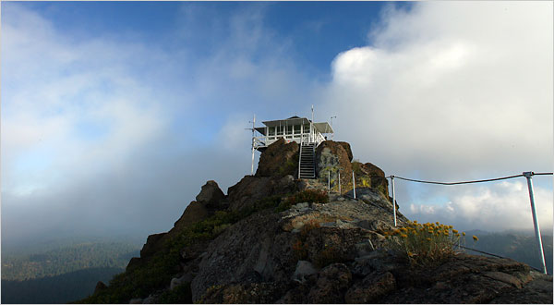
2. Customer Support (or CYA)
Be on the lookout for problems that you can proactively solve.
Notes:
Tim: The whole theme here is that customers are already participating in conversations, with or without you. Support is a key area that can establish good reputation with a customer base and generate WOM recommendations. An important catch to remember here is that once you engage, you have to stay engaged and fully commit. Proactive online support can open the flood gates and even if you aren’t prepared for it at first, you need to be committed to stick with it.
Allison:
1. Customer support. This is the biggest, as it actually reduces our support costs. As an Internet service, we often find out about issues nearly immediately via Twitter and can communicate that they’re resolved to hundreds of people via one tweet.

Slide 6

3. Look for Customers. Retain Customers.
Your potential customers are online. Find them.
Get to know them. Make sure they know you.
Notes:
Tim: This is where conversation monitoring and influencer identification are key. If you’re just starting into social media engagement, you need to sit back and watch for a while. You will likely find your niche discussed in various communities and each community operates in its own particular way. Pay attention to how open the community is, how its members interact, and now potential vendors are treated in the conversation. Communities based around something like Twitter are usually pretty open and accepting, but if you get into tightly-knit groups like discussion forums you will find they have a unique culture that must be understood before diving in.

Slide 7

4. Community Engagement
Know who matters. Connect. Stay Engaged. Be part of it.
Notes:
Tim: This is where conversation monitoring and influencer identification are key. If you’re just starting into social media engagement, you need to sit back and watch for a while. You will likely find your niche discussed in various communities and each community operates in its own particular way. Pay attention to how open the community is, how its members interact, and now potential vendors are treated in the conversation. Communities based around something like Twitter are usually pretty open and accepting, but if you get into tightly-knit groups like discussion forums you will find they have a unique culture that must be understood before diving in.

Slide 8

5. New Product Ideas
Listen for complaints. Tune into “wishes”. Watch for hacks.
(or just ask)
Notes:
Tim: Alluding to crowdsourcing, this is a popular, effective, and potentially dangerous tactic – which makes it all the more important. Engaging with your audience is of course a 2 way street and listening is a HUGE part of that. Fixing and improving things within your company is invaluable and should be a mandatory part of your social media strategy, with top-down support from the CEO. “Crowdsourcing” is a little trickier, because you can’t just dip your toes in the water to see how it feels. If you open the door to changing, or more importantly creating, products based on audience feedback, you need to commit internally to follow through or risk alienating your most important resources – your customers.
An important thing to keep in mind with customers, whether they are yours or someone else’s, is that they will talk a lot about how much they would love XYZ feature/product/etc. But when it comes time to introduce this product, especially if it is done at a premium over existing solutions, suddenly the talkers aren’t walking the walk. This is more of a concern with direct consumers rather than B2B customers, but something to never lose sight of.

Slide 9

6. Marketing & Campaign Effectiveness
Know where you are BEFORE you hit “go”
and track your impact out in the world

Slide 10
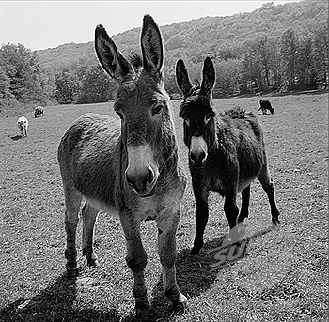
7. Competitive Intelligence
Listen to what your competitors are saying, and what customers are saying about them
Notes:
Tim: Take everything you know about and have done with monitoring your brand, and duplicate it – literally. Competitive intelligence is a hugely untapped resource of social media, and the internet, in general. Wondering what people like/dislike about another company’s product that directly competes with yours? Wonder no more – if your shared audience pool is online and talking, you can find out and it will only cost you time and any monitoring tools you use.
Allison:
Competitive intelligence. We can see what our competitors are doing via Twitter, and again, being Internet companies, can see when our competitors are having problems and leverage. (ex: An ISP’s service is down. We can tweet that OpenDNS is not down and invite the ISP’s customers to switch to OpenDNS.) Real-time insight in our business is invaluable.

Slide 11

8. Strategic Business Intelligence
Social Media is the Mind of the Market.
What else would you like to know?

Slide 12
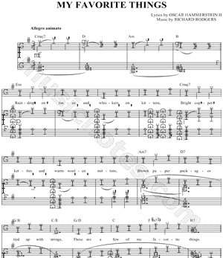
9. Be a Thought-Leader
What is capturing your attention right now?
Notes:
Tim: If you are relatively unknown or at least not known in the “mainstream” of your industry, thought leader strategies can help put you on the map and make you a “household” name so to speak. And if you are the “experts” in your industry, and everyone thinks/knows so, don’t rest on your laurels – continue to prove it.
Thought leadership is as easy to start as getting an evangelist or expert (or many of them) on a blog and start writing – not necessarily about your company and products, but about your industry. Talk about the cool things that are happening, and why they are cool – or why they aren’t cool. Publish whitepapers or super-long-blog posts about a hot issue in your industry. Touting the company line here is okay and occasionally necessary, but the focus needs to be on showing that your company is the best at what it does, without pitching your products directly.
When you’ve gotten in the groove, start expanding. Share your content everywhere applicable. Join conversations outside of your own backyard. Start conversations. Work towards getting quoted, mentioned, and interviewed in the mainstream/influential publications & properties. This is the road to being the “household name.”

Slide 13

10. Humanize your Company
Companies are made of people. Prove it.
Notes:
Allision:
We communicate with users through our Facebook page, and I accept friend requests from most customers. I can see that the customer is actually a father of two who likes to garden, not just the network admin at a SMB. And he can see that I’m a real person with a life outside of work, too. Facebook is an appropriate place to use a more informal tone, increasing the likelihood you’ll actually connect with a customer. (In some instances, marketing pros should take caution when accepting friend requests from customers.)
Tim: My boss at my last social media position decreed that the “royal We” was to be banned from our social media communications, of any kind. Blogging, Tweeting, and posting about “We/Us/Our” doesn’t help your audience connect as well as “I/Me/My.” Team recognition and company acknowledgement has its place, but talk about Your thoughts, what You think, and how You can help.
Put names and faces to your communications. Let your people express themselves, within reasonable limits.

Slide 14
Uses for Social Media
Spread the Good Word
Customer Support (or CYA)
Customer Acquisition. Customer Retention
Community Management
Find new product ideas
Marketing / Campaign Effectiveness
Competitive intelligence
Strategic Business Intelligence
Establish Yourself as a Thought-Leader
Humanize your company

